Slide 1

Learning local behavioral sequences to better infer non-local properties in real multi-robot systems
Taeyeong Choi, Sehyeok Kang, and Theodore P. Pavlic
Science and Engineering of Autonomous Decision-making Systems (SEADS) Lab

Slide 2
Remote Teammate Localization (ReTLo)
H
F3
F2
F1
T
Could I infer where all of my remote teammates are?
I only know about my nearest neighbor, F1 though ...

Slide 3
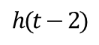
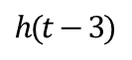
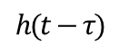
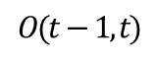
Observation
Prediction
F1’
H
F1
…
F3
T
F2
$$O(t−1, t)$$
H
. . .
F3
Historical sequence
F2
H
H
H
F3
…
F3
F3
F1
F2
F2
F2
F1
F1
F1
T
T
T
T
$$h(t−τ)$$
$$h(t−3)$$
$$h(t−2)$$
Let me use the prior knowledge and current observations !

Slide 4
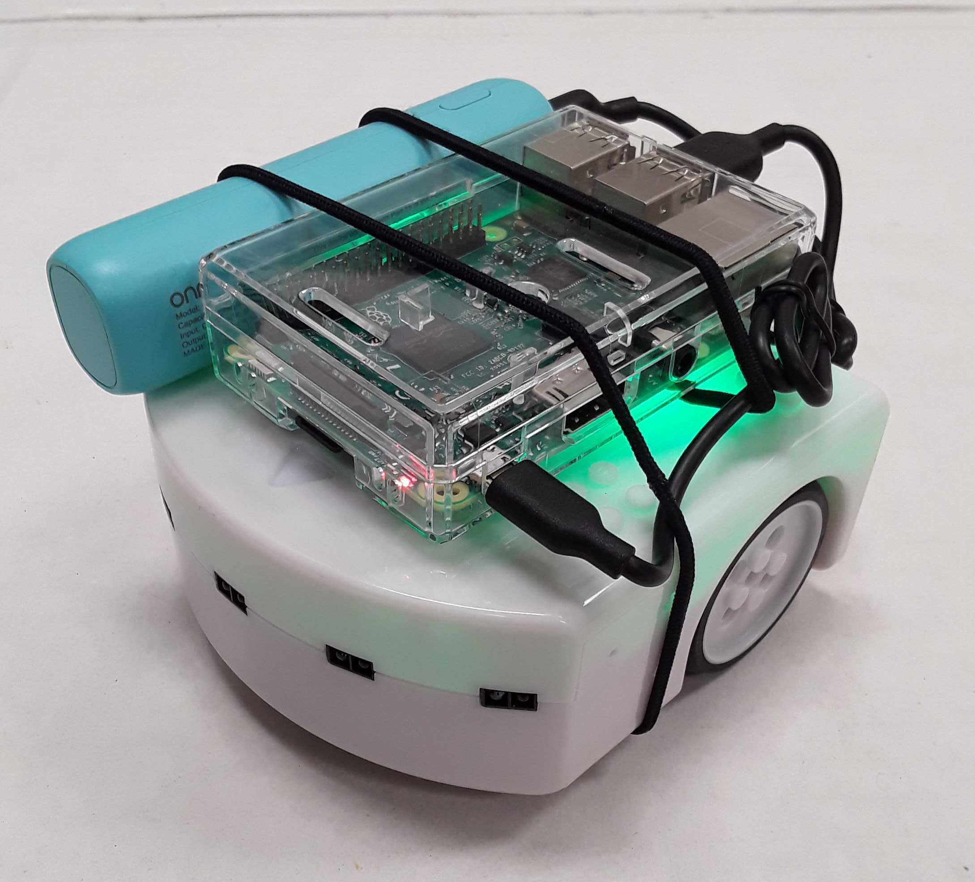

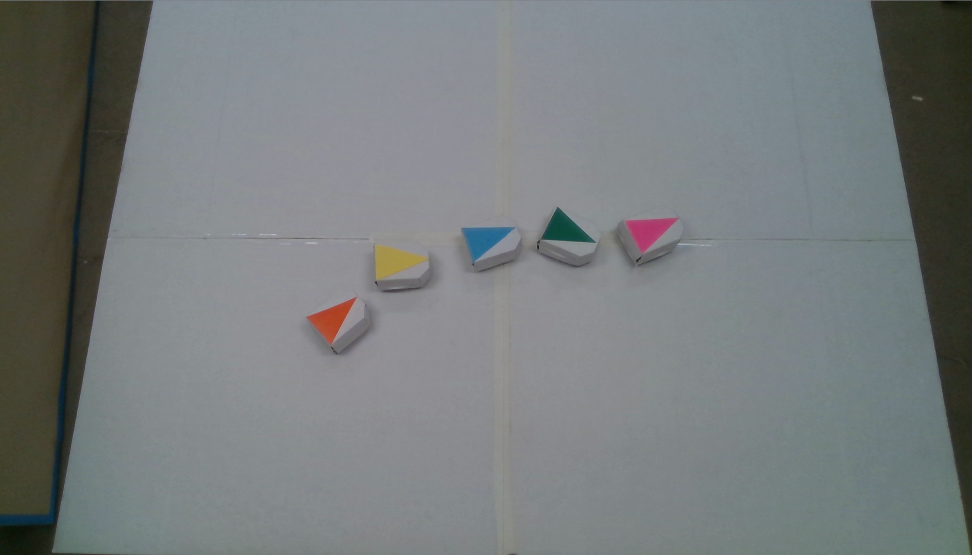


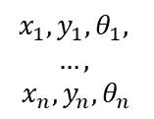
A commercially available, two-wheeled robotics platform, Thymio, equipped with Raspberry Pi
2.5 meters
$$x_{1},y_{1},θ_{1},$$
$$…,$$
$$x_{n}, y_{n}, θ_{n}$$
1.9 meters
A central computer with an overhead camera to simulate more generic proximity sensors and a virtual GPS system

Slide 5
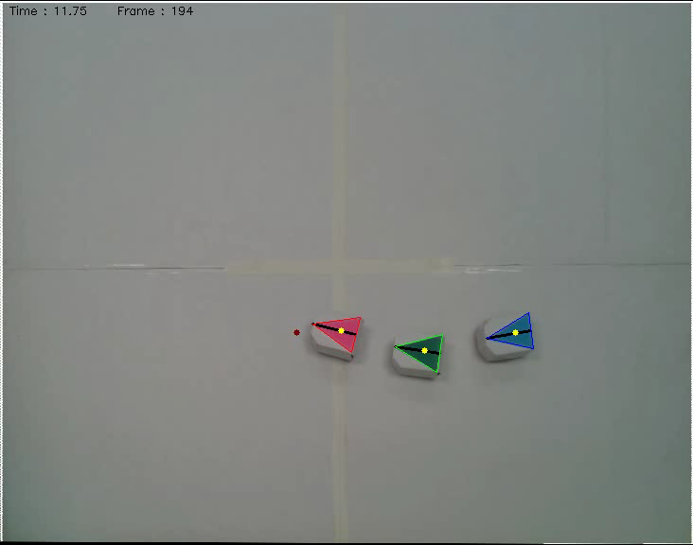
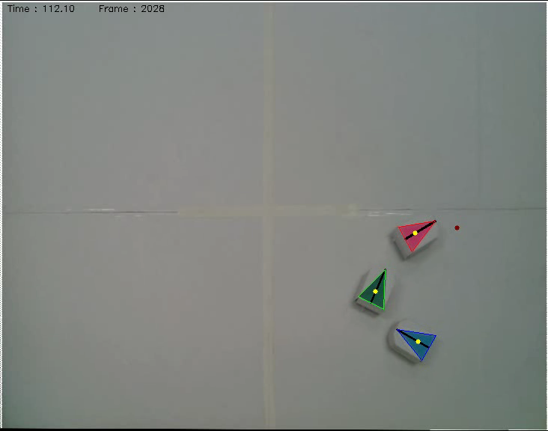
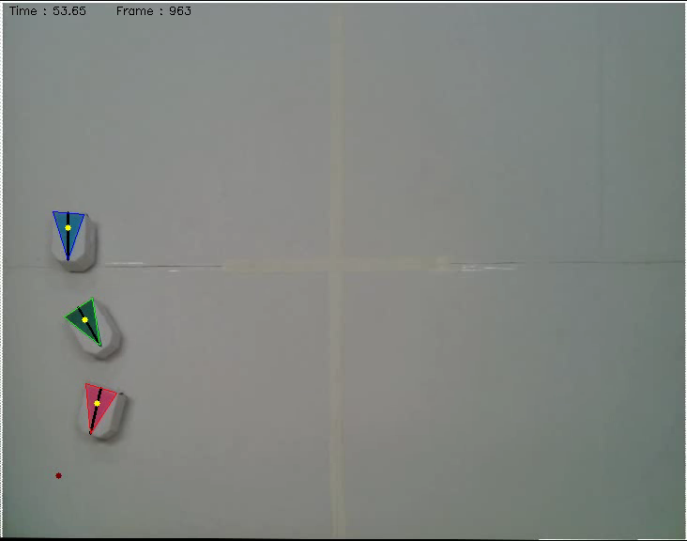

With 12k data samples, our model on Tail learns to predict the pose of Head by using historical team formations, $h$, and recent observations of Follower, $o$
An off-the-shelf detection algorithm collects
x,y-coordinates and orientations in a 3-robot team
as the Head is moving toward random destinations

Slide 6
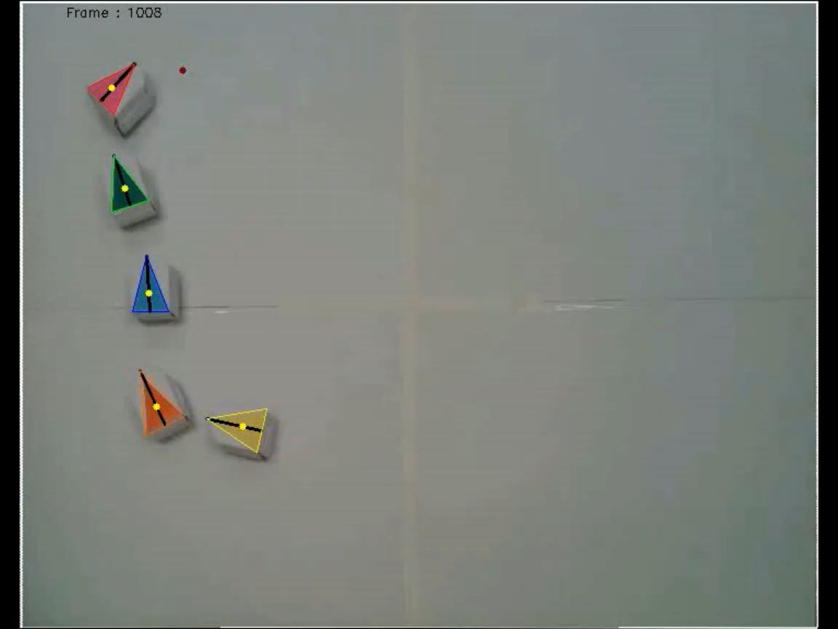

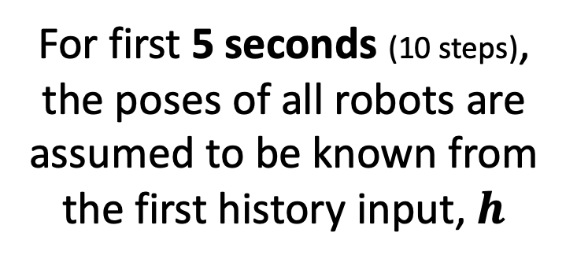
Prediction Scaled to a Larger Team
T=
Head
For first 5 seconds (10 steps),
the poses of all robots are assumed to be known from
the first history input, $h$
Follower 3
Follower 2
Follower 1
Let me introduce how
I infer multiple teammates
by only observing F1!
Tail
Recorded at 2FPS and displayed 2x slower

Slide 7

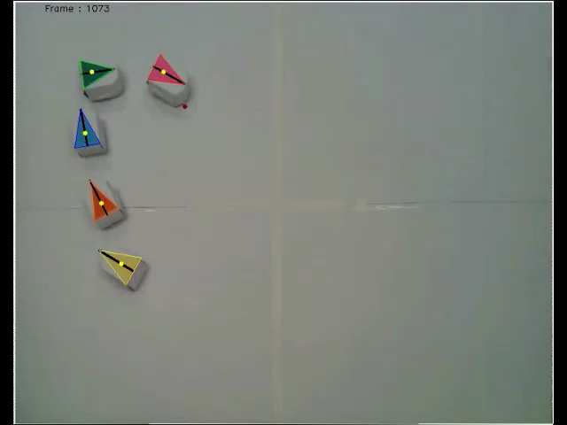
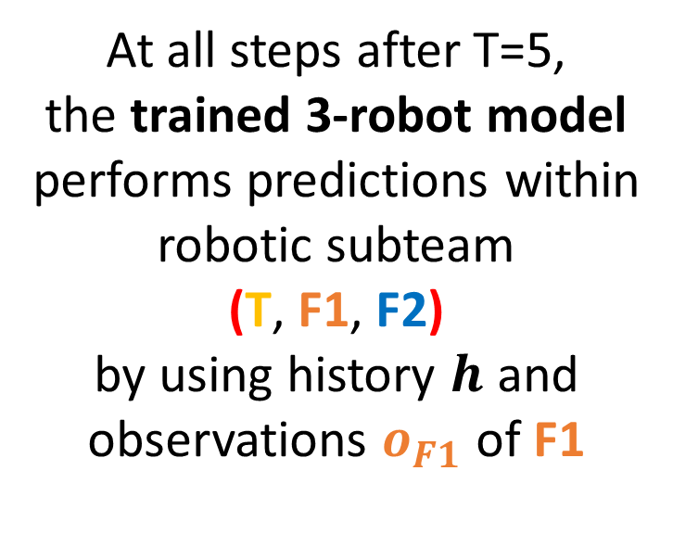
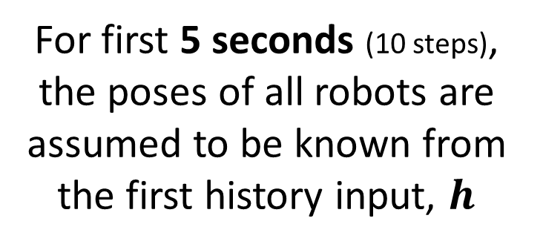
Prediction Scaled to a Larger Team
T=
At all steps after T=5,
the trained 3-robot model performs predictions within
robotic subteam
(T, F1, F2)
by using history $h$ and observations $o_{F1}$ of F1
For first 5 seconds (10 steps),
the poses of all robots are assumed to be known from
the first history input, $h$
Recorded at 2FPS and displayed 2x slower

Slide 8
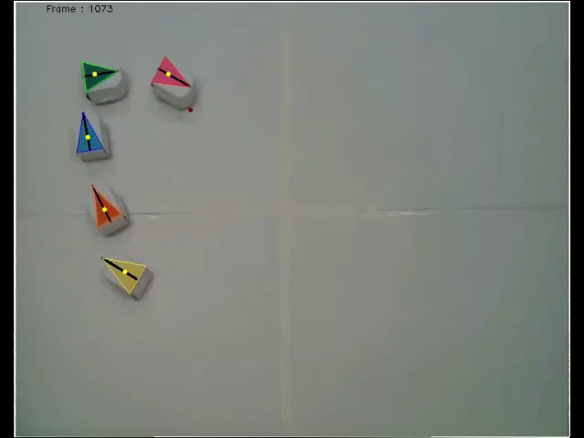
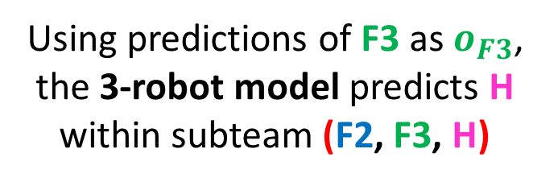
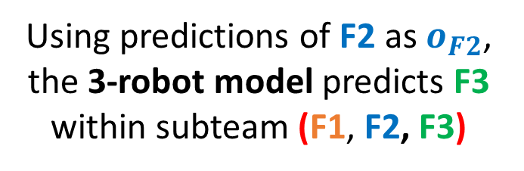
Using predictions of F2 as $o_{F2}$,
the 3-robot model predicts F3
within subteam (F1, F2, F3)
Using predictions of F3 as $o_{F3}$,
the 3-robot model predicts H
within subteam (F2, F3, H)
T=
T=
In other words,
I predict as if
I was F1 or F2
Recorded at 2FPS and displayed 2x slower

Slide 9
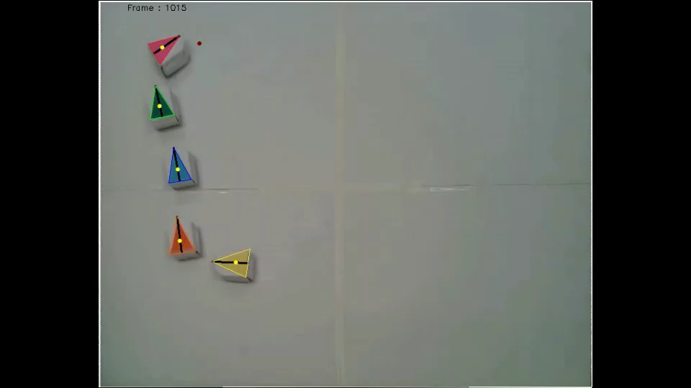
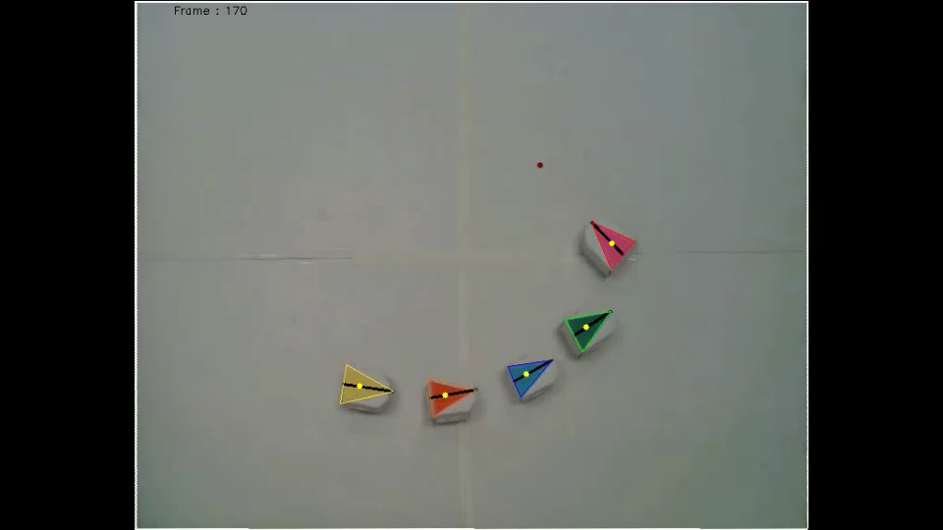
Examples of Full Predictions
(played at 2x slower speed)
Iterative application of the trained
3-robot model accurately predicts positions of remote robots in teams of larger than 3 without explicit signaling

Slide 10
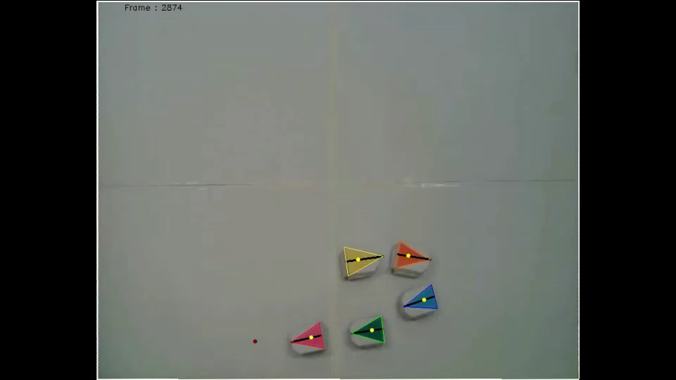
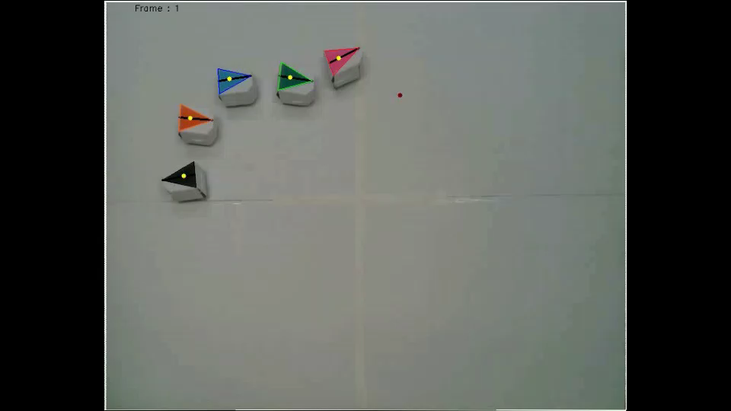
Examples of Full Predictions
(played at 2x slower speed)
Iterative application of the trained
3-robot model accurately predicts positions of remote robots in teams of larger than 3 without explicit signaling

Slide 11
Learning local behavioral sequences to better infer non-local properties in real multi-robot systems
Taeyeong Choi, Sehyeok Kang, and Theodore P. Pavlic
Science and Engineering of Autonomous Decision-making Systems (SEADS) Lab
Thanks!
Thanks!

